Slide 1
Programming Fundamentals
by Abeeha Sattar

Slide 2
Computer Languages
Low-Level Languages: very close to the hardware, small code, very efficient, but also very difficult to master. E.g. Machine Code/Assembly Language
Medium-Level Languages: somewhere between high-level and low-level languages. You need some understanding of the underlying architectures, but it is more user friendly than low-level languages. Some argue C is a middle level language now.
High-Level Languages: these designed to be user friendly, with increased readability and try to follow syntax similar to natural language. Most recent languages, like Java, C#, Python, Perl, Ruby, etc.

Slide 3
So… Why C?
C is the “mother of all languages”
It provides the fundamentals and basis for all other languages.
Variables, datatypes, control structures, memory management.
Relatively “smaller” than other languages.
If you can master this, you can master anything else!

Slide 4
Online Compilers
Feel free to use them to attempt to code during class. But… Still get used to writing code on paper as well.
https://www.programiz.com/c-programming/online-compiler/
https://www.onlinegdb.com/online_c_compiler

Slide 5
So… How does a Program Work?
High Level Code → Compiler → Executable File (.exe)
The program/code that you wrote
The file that can be run by your computer

Slide 6
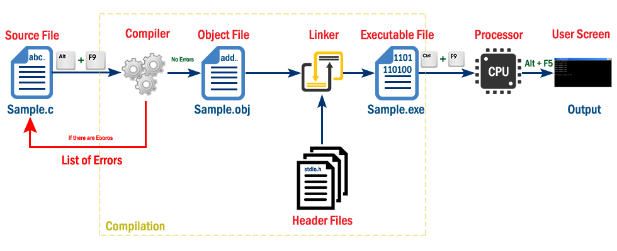
More Details (yay!?)
http://www.btechsmartclass.com/c_programming/C-Creating-and-Running-C-Program.html
Notes:
Source file: Contains your code
Compiler: Responsible for compiling your code
Object File: Machine code generated by the compiler (usually binary format)
Linker: Combines different functionalities from “headers” to the object file, to create an executable file
Header Files: Contain basic required functionality for your program

Slide 7
Writing a C Program
We’ll be using some text editor to write/edit our C code.
The file containing your code is the “source file” and your code is the “source code”
You MUST compile the source code present in the source file before the program can be executed or ran.

Slide 8
Your First Program a.k.a. Hello World!
Preprocessor Directive and Header Files
#include <stdio.h>
int main(void)
{
// This is a comment
printf("Hello World!\n");
/* This is a
multi-line comment*/
return 0;
}
Main Function
Curly Braces = Start of Function
Comment
Output Stament
Multi-Line Comment
Return 0 at the end of main
Curly Braces = End of Function

Slide 9
Preprocessor Directive
Lines that begin with a # in column 1 are called preprocessor directives (commands)
#include directive causes the preprocessor to include a copy of the standard input/output header file stdio.h at this point in the code
stdio.h contains information about the printf() function that is present in the program

Slide 10
Libraries / Headers
When we write our programs, there are libraries of functions to help us so that we do not have to write the same code over and over.
Some of the functions are very complex and long. Not having to write them ourselves make it easier and faster to write programs.
Using the functions will also make it easier to learn to program!
stdio.h is one of those libraries, and printf() is a function present inside it.

Slide 11
The Main() function
int main (void)
It is the entry point of your code.
Anything written inside it will start executing when you run your program
main() is placed in the source code file as the first function for readability.
The reserved word “int” indicates that main() returns an integer.
The parentheses following the reserved word “main” indicate that it is a function.
The reserved word “void” means nothing is there.

Slide 12
The Body of a Function
Curly braces signify the start and end of a function.
Opening curly brace ‘{’ marks the start of a function.
A corresponding closing curly brace ‘}’ marks the end of the function.
Do keep in mind that you do need to match the braces, otherwise it will lead to errors in your code.
Each opening brace should have a closing brace and vice versa.

Slide 13
The printf statement/function
printf (“Hello World!\n”);
This line is a C statement.
It is a call to the function printf ( ) with a single argument (parameter), namely the string “Hello, World!\n”.
Any sequence of characters written between quotation marks “…” is a string.
Even though a string may contain many characters, the string itself should be thought of as a single thing.
Notice that this line ends with a semicolon.
All statements in C end with a semicolon – the full stop of C.

Slide 14
The return statement
return 0;
In C programs the main function is of type int and therefore it should return an integer value.
The return value of the main function is considered the "Exit Status" of the application.
On most operating systems returning 0 is a success status like saying "The program worked fine".

Slide 15
Comments
Text written inside your source code which the compiler ignores.
Anything written after // will be ignored by the compiler when compiling your source code.
Anything written between /* and */ will also be ignored when compiling the source code.
You can use it to comment out buggy code, or to annotate your code to help increase readability/understandability if someone else was reading your code.

Slide 16
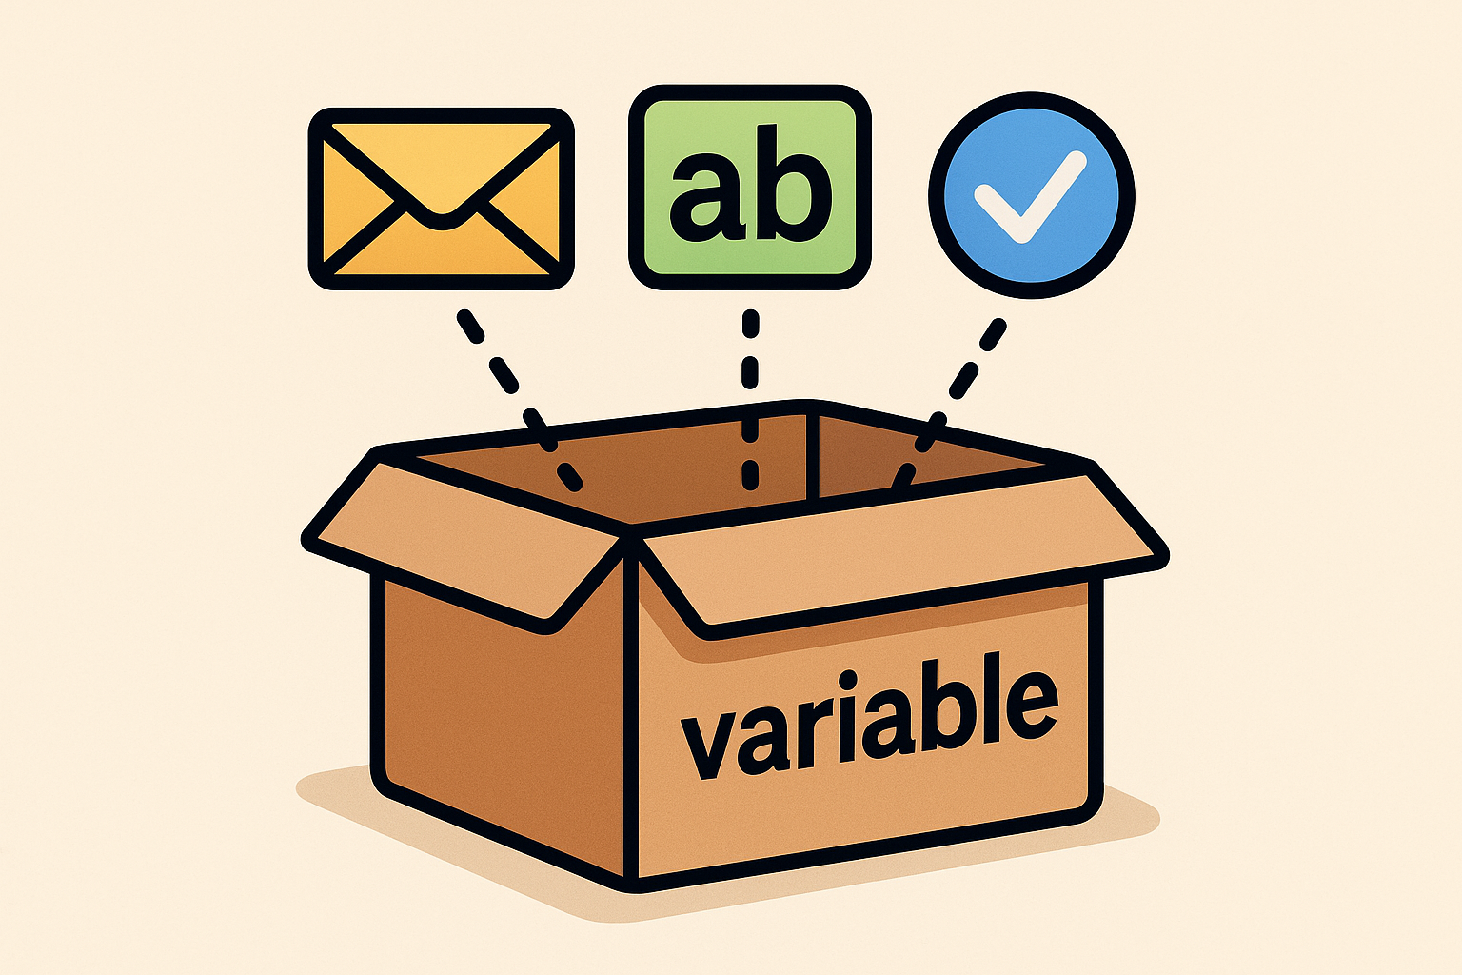
Variables
A variable is a space in the computer’s memory set aside for a certain kind of data and given a name for easy reference.

Slide 17
Variables
Declaring a variable/ Declaration:
int x;
int y,z;
float a,b,c;
char z;
Initializing a variable/ Initialization:
x = 10;
z = ‘A’;
a = 1.99;
Declaration + Initialization:
int w = 1;
Syntax:
datatype variable_name = value;

Slide 18
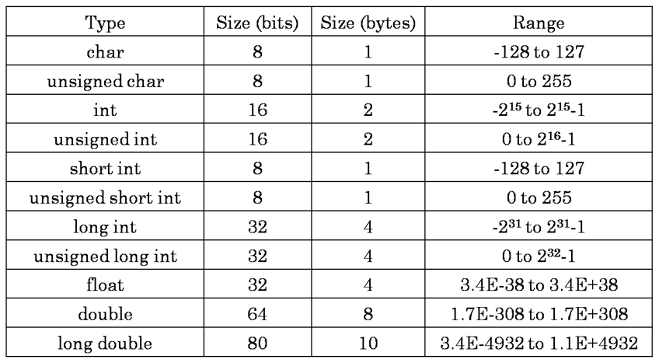
Dataypes
https://www.startertutorials.com/blog/data-types-c.html

Slide 19
Printing the value of your variable on console
int myVar = 10; // declaring and initializing myVar
printf(“The value is: %d”, myVar);
So… What’s %d?

Slide 20
Format Specifiers
The printf function has a special formatting character (%) -- a character following this defines a certain format for a variable:
%c – characters
%d – integers
%f – floats e.g.
printf(“%c %d %f”,ch,i,x); // assuming: char ch = ‘c’; int i = 1; float x = 1.1; NOTE: Format statements are enclosed in “...”, and variables follow after the comma
Make sure order of format and variable data types match up.

Slide 21
Other Format Specifiers
%c Single Character
%s String
%d Signed decimal integer
%f Floating point (decimal notation)
%e Floating point (exponential notation)
%u Unsigned decimal integer
%x Unsigned hexadecimal integer
%o Unsigned octal integer
l (small L) prefix used with %d, %u, %x, %o to specify long integer (e.g. %ld) %lf long double (small L)

Slide 22
Example
#include <stdio.h>
int main(void) {
int slot = 6;
char section = 'C';
printf("Welcome to Programming Fundamentals!\n");
printf("This is the %dth sloth, and the section is BCS 1-%c", slot, section);
return 0;
}

Slide 23
Escape Characters/Escape Sequences
There are some things you cannot put directly inside the double quotation marks. (like newline, \, ?, single quotes, double quotes, etc). Here’s some escape sequences we use often:
\n – new line
\t – tab
\b – backspace
\r – move to line start
\\ - add \
\? – add ?
\’ – add a single quote
\” – add a double quote
\a – play a beep/bell sound

Slide 24
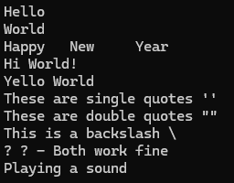
Example
#include <stdio.h>
int main() {
printf("Hello\nWorld\n");
printf("Happy\tNew\tYear\n");
printf("Hello \b\b\b\b\b\bHi World!\n");
printf("Hello World \rY\n");
printf("These are single quotes \'\'\n");
printf("These are double quotes \"\"\n");
printf("This is a backslash \\\n");
printf("? \? - Both work fine\n");
printf("Playing a sound \a\n");
return 0;
}

Slide 25
Operators
Symbols that we can use to perform different operations on variables in our program.
There’s different types of operators:
Arithmetic operators (+, -. *, /, %)
Assignment operators ( =, +=, -=, *=, /=, %=)
Increment/Decrement operators (++, --) – is further divided into pre and post increment/decrement operators. (e.g. ++a, a++, a--, --a; given ‘a’ is a variable.
Relational operators (==, <, >, <=, >=, !=)
Logical operators (&&, ||, !) – AND, OR and NOT operators
Bit-wise operators (&, |, ^, ~, <<, >>)

Slide 26
Tasks (Solve all by declaring/initializing vars)
Write a program to calculate and display the average of 3 integers.
Write a program to calculate the area of a circle given a radius and display it. (Hint: use floats here)
A = π r² (assume π = 3.142)
Create an integer variable and assign it the 4 digits of your roll number. Split the number into units, tens, hundreds and thousands and display it as: 2Th 0H 3T 4U (done for the number 2034)
Write a program that converts a decimal number into a binary number.
But before that, let’s discuss the number systems and logic behind this!

Slide 27
Fin~

